Slide 1
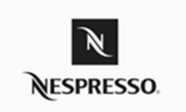
NEW Herbal Tea Capsule in Brief
- Quality; Innovative;
- Exclusiveness (distribution channels); and
- Personal Touch (long term customer relationship)
- Super-Premium brand > luxury “Nespresso experience” > innovative concepts
- Quality, Convenient, Stylish, Positive cup at a location you choose
- Line Extension: Alternative options from coffee with same luxury experience
- Niche single-served brewing herbal tea segment
- Middle to high income sophisticated women executives target
- Core target non coffee drinkers but/and in search of luxury indulgence
- Upscale, stylish and premium image position
- Star endorsement through interesting storytelling
Objectives
and
Rationale
Segment
Target
Position
Brand Equity
Product
Differentiation
Nespresso (2018)
Notes:
First of all, I would like to provide a recap of our new product.
Our Herbal tea capsule will be a line extension of Nespresso, providing alternative options other than coffee capsules but have the same luxury experience.
As the company aims to establish Nespresso as a Super-Premium brand by creating the luxury “Nespresso experience” through its innovative concepts,
to offer quality, convenient and stylish beverages at a location you choose.
Being in the beverage market, our Focus is on the niche single-served brewing herbal tea segment
With target on the middle to high income sophisticated women executives and core target on those who happens to be non coffee drinkers but also in search of luxury indulgence
We continue to position our brand the upscale and premium image through star endorsement with interesting storytelling to deliver the true product value
Our competitive advantages are quality, innovative and exclusiveness especially on our distribution channels. For example, our capsules can only be purchased at our stores or ordered online through membership, and most importantly the unique personal touch as we strive to maintain a long term relationship with our customers who also are our members.

Slide 2



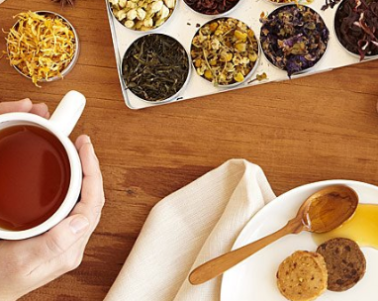
Sales Management
The importance of Sales Management towards our new product:
Continue to maintain a close relation with our customers and members
Bring positive image, allow them to pass on to others
Develop a team of expertise who also is our sales force
Introduce herbal tea capsule, product features, functions and benefits
Test the water, understand and collect marketing intelligence
Archive our company goals and objectives
Notes:
As Connie mentioned, we strive to establish and maintain a close relationship with our customers and members. Therefore, personal selling is vital for our new product as it allows us to bring our message across to our customers and establish the positive image for our product and brand as we want.
It also helps us to introduce our new product features to our targeted customers, especially tea is something you only know if they like it or not by letting them to taste it and experience it.
For this reason, we need to develop a team of expertise specialized on herbal tea, the same as our current coffee experts who also is our sales force. We want to make sure our customers know our product features, selections and benefits. So they can obtain the best quality and fit to their taste.
On the other hand, direct selling is one of the best ways to test the water and collect marketing intelligence (as we want to know the reactions of the market concerning our new products, especially from our target customer and potential customers). This way we can better understand the market and any area of opportunity for future development.

Slide 3
Sales Management Techniques - A
iii) Salesperson Criteria
- Smart, Professional,
Knowledgeable and passionate on tea, coffee and Nespresso machine
- Attentive, customer service centric
i) Integrate with other promotion elements:
- Personal selling: Personal touch (develop long term customer relations) with positive influence on purchase
- Sales promotions, advertisement and e-marketing to attract attention & introduce to mass market shortly (Turner, 2017)
i
A) Develop sales force objectives
iv) Direction and purpose to sales force
- Guideline & briefing on company value, job responsibility, how to do & what to do
- Mutual objectives
ii) Expected sales target
- KPI
- Target standard: sales volume, revenue, associated sales figure (because of herbal tea capsule to buy machine, new join member, repeat sales)
- Timeline: several stage
Notes:
To do all this, we need to apply different sales management strategy.
Being in the early stage of our new product development, our first priority is to create awareness in the consumer market.
Apart from Personal Selling, it is important and more effective to combine sales promotions, advertisements, and internet marketing.
As our target customers are smart business women, our sales force have to be knowledgeable on the products with charming personality at the same time. They need to demonstrate self-confidence with the required knowledge and skills to be consistent with our brand image – smart and professional. We seek for people with passionate and creative characteristics that can maintain Nespresso’s excellence brand image.
We propose to set our sales target base on KPI such as sales volume, revenue and associate sale figure which machine buying, new join members and repeat sales because of new herbal tea capsule. To be more realistic, there will several stage based on actual performance.
We will also set proper guidance to our sales force on company value, their job responsibility and expectations, what and how to do.

Slide 4
Sales Management Techniques - B
i) Specific sales objectives set
- Gain customers’ awareness (more sales force reach target customer easier)
- Sales volume (after market aware the new product)
- Revenue (profit margin, associate sale, repeat order)
ii) IMC strategy
- Promotion: more sales force for pop up store and booths
B) Determining sales force size
iv) Sales force for new herbal tea
- Assign 10% headcount based on HK boutiques headcounts
- Ratio based on 2010 statics (Nespresso, 2010)
iii) Sales vs profit generation
- Beginning: growth expense in sales force & promotion
- Future: generate profit of repeat order
Notes:
For determining sales force size, specific sales objective will be set for difference stages.
Such as gain awareness, more sales force can be easier to reach target customer and have their attention in early stage.
We focus on promotion which more sales force will be needed for pop up store and booths.
In beginning lower profit generated, as more expenses spend in sales force and promotion event. In future, repeat order will generate profit.
As the result, we suggest to assign 10% of headcount based on current HK boutiques head counts.
(Original)
B) Determining sales force size
Specific sales objectives set
Main sales objectives are gain customers’ awareness in stage 1 and sale volume in stage 2 and revenue in stage 3. More sales force can be easier to reach to target customer and letting them be more interested in our herbal tea. When the market realise our new herbal tea capsule, sales force focus on promotion to gain the sale volume.
Nature of IMC strategy
Focus on promotion, more sales force will be needed for pop up store and booths. Assuming 1 teams per 1 unit.
Influences sales and profit generation
New launch of brand-new line for Nespresso, more expense in sales force and promotion will be invested and lower profit margin in beginning. Future profit margin will be increased after repeat order generated.
As the result, 10% of headcount add based on current HK boutiques head counts. Ratio base on Nespresso 2010 statics (3000 specialist vs 100,00 customer).

Slide 5
Sales Management Techniques - C
ii) Continuous training
- External: Product knowledge training (outsource to external specialists )
- Internal: Sales and customer service technique training (especially on middle-high income women professionals)
- Ensure service level
- Staffs feel valuable, being respect, increase morale
i) Hiring Criteria's
- First impression to customer
- Passions and wide knowledge on tea & Nespresso machine
- Good listener, friendly, honest
- Love interact with customer
C) Recruiting, selecting and training
iii) Manpower (In house, and outsourced)
- 5% existing Sales team
- 5% addition head counts on promotion table (temporary)
- All staff must attain the training for our new herbal tea capsule
- Guarantee to offer superior experience to customer, consist with Nespresso brand image
Notes:
How to recruit the right representatives of Nespresso as first impressions to the customers?
Passions and knowledge are core hiring criteria.
Beside they should understand customers’ needs to give the consultations friendly that help to get more marketing intelligence.
Training will be offered continuously focus on new herbal capsule and target customer.
To ensure every staffs let our customers feel exclusive and increase staffs' morale.
5% of existing coffee expertise and 5% outsourced for temporary staff assign in promotion period for new herbal tea capsule line. This approach can balance cost and service quality.
(Original)
C) Recruiting, selecting and training
Right Type
As being representative of Nespresso, tea specialists for personal selling and promotion are the first impressions of Nespresso of the customers. Passions and wide knowledge on tea and Nespresso machine are hiring criteria. Beside they should be a good listener and friendly that understand customer need and give the consultation and let people want to get close to with honest character. Loving interaction with customer is distinction that help to get more marketing information.
Continuous activity – training (external, internal)
External: Product knowledge training (may outsource training by herbal tea experts)
Internal: Sales and customer service technique training specific for new herbal tea capsule especially for middle-high income women professionals (such as posture, manner, body language, observation skill, selling skill as consultant).
Benefit of training: to ensure every staff service quality can let customers feel exclusive for our new herbal tea capsule. Staffs feel valuable and being respect by studying new knowledge and attain the training thus increase morale.
In-house or outsourced
Existing Sales team and an addition head counts on promotion table
As mentioned before, 10% of HK boutiques’ headcount will assign for new herbal tea capsule promotion, there will be 5% of existing coffee expertise and 5% outsourced for temporary staff in promotion period. This approach can balance cost and service quality. Of course, both existing coffee expertise and outsourced temporary staff must attain the training for our new herbal tea capsule idea, knowledge and customer service skill to guarantee our target customers have superior experience to consist with Nespresso brand image.
D) Controlling and evaluation
Requires information – managed and use effectively
Record and report all major questions and enquiries from customers
Record top selling product
Record comments and feedback from customers
All customers’ information will be evaluated and saved in Nespresso’s database for future marketing strategy modification and development for new taste ingredients. Also, being base for predict customer behaviour.
Remuneration/ compensation system: straight salary, straight commission or combination
Rewards on achieving sales target
We tend to combination of basic salary and commission for our tea specialists / staffs in new tea capsules. Beside the commission for achieving sales target, there is special rewards for sales target of new herbal tea capsule for the team as booth / store. It is the way to prevent the vicious competition, but motivate staffs more proactive.
Comparison of sales objectives and sales performance / evaluation of whether target have been met
Evaluate the sales performance every week ensure the sales progress stick on the plan and target can be meet. If lower standard, work with front line tea specialists / staffs to found out the problem and fix it.
Enables corrective action
Innovative is one of key lead Nespresso success and keeping improvement of its new products allow Nespresso to achieve excellence. Meeting or discussion with tea specialists/ staffs every week will be performed and have the feedback and comments from customers and staffs to evaluate the actual market. Which allow improvement and adjustment to react to market immediately by strategy correction.

Slide 6
Sales Management Techniques - D
i) Collect Market Intelligence
- Collect questions, enquiries, comments and feedback from customers
- Collect and analyze Top selling product data
- Customer behavior, market strategy modification, new taste development
ii) Combination of basic salary and commission
- Special rewards for selling new herbal tea capsule
- Prevent vicious competition, motivate staffs to be proactive
D) Controlling and evaluation
iv) Enables corrective action
- Continuous improvement to strive excellence
- Meeting / discussion with tea specialists/ staffs regularly
- Customers’ feedbacks / comments to evaluate market
- Improvement and adjustment to market change
iii) Sales objectives & performance comparison
- Review sales performance every week
- Ensure sales progress on track
- Maintain service standard, work with front line staff to resolve challenges
Notes:
Our tea specialists are required to record and report market intelligence and top selling product. All information will save in Nespresso’s database for evaluation.
Combining basic salary and commission for our tea specialists / staffs.
Special rewards for new herbal tea capsule will offer for the team which can prevent the vicious competition but motivate staffs.
Evaluation of sales performance weekly ensure the sales progress meet target. Will work with front line staffs to solve challenges to maintain service quality.
Keeping improvement is the way to make Nespresso to strive excellence.
Thus, meeting or discussion regularly will be held for evaluate the actual market.
Correction plan allow improvement and adjustment to react to market immediately.
(Original)
D) Controlling and evaluation
Requires information – managed and use effectively
Record and report all major questions and enquiries from customers
Record top selling product
Record comments and feedback from customers
All customers’ information will be evaluated and saved in Nespresso’s database for future marketing strategy modification and development for new taste ingredients. Also, being base for predict customer behaviour.
Remuneration/ compensation system: straight salary, straight commission or combination
Rewards on achieving sales target
We tend to combination of basic salary and commission for our tea specialists / staffs in new tea capsules. Beside the commission for achieving sales target, there is special rewards for sales target of new herbal tea capsule for the team as booth / store. It is the way to prevent the vicious competition, but motivate staffs more proactive.
Comparison of sales objectives and sales performance / evaluation of whether target have been met
Evaluate the sales performance every week ensure the sales progress stick on the plan and target can be meet. If lower standard, work with front line tea specialists / staffs to found out the problem and fix it.
Enables corrective action
Innovative is one of key lead Nespresso success and keeping improvement of its new products allow Nespresso to achieve excellence. Meeting or discussion with tea specialists/ staffs every week will be performed and have the feedback and comments from customers and staffs to evaluate the actual market. Which allow improvement and adjustment to react to market immediately by strategy correction.

Slide 7


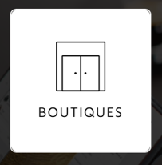
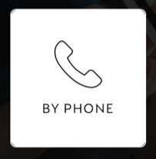
Sales
Internet (60%)
Retail Stores (23%)
Customer Relationship Center (17%)
Internet Marketing (e-retailing)
Nespresso USA
Nespresso, 2018
Notes:
According to the Sales report of Nespresso capsules in USA in 2014, the percentage in placing orders via internet was 60%, retail stores was 23% and 17% by phone.
This shows that internet was our primary channel of Nespresso’s sales.

Slide 8


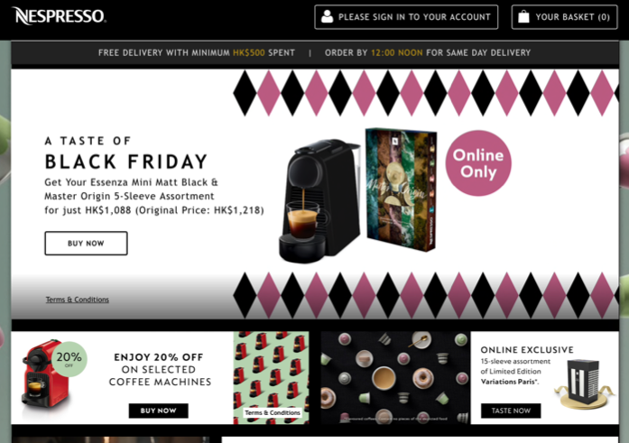
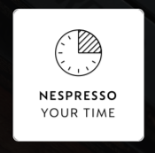
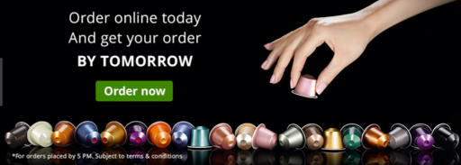
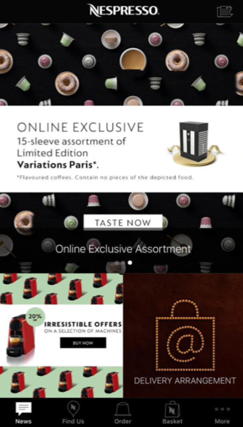
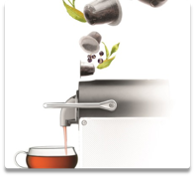

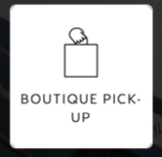
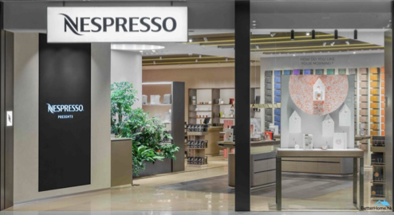
Internet Marketing (e-retailing)
Nespresso website and app
(E-coupon, eDM)
O2O (online-to-offline)
Source: Google, 2018; Nespresso, 2018
Device in store and online to display the origin of the herb
Notes:
For that reason, we will place big focus on our e-marketing strategies.
Currently, our website and mobile app allow our members to tap into the world of Nespresso anytime in anywhere. As a member of the Nespresso club, they can enjoy numerous
benefits such as placing their orders via online or mobile app. It also provides various members privileges with the latest information on capsules and machines to match their taste and preferences. After purchasing a Nespresso machine and placing their first order, customer can register online or at our boutique to become a member.
To increase awareness of our new product, we would have our new product advertisement popped up on the front page of our website and mobile app to draw attention from our customers.
We would also blast out eDM with e-coupon for inviting our members to join some tasting events at our boutiques, they are encouraged to bring their loved ones, relatives or friends to join, to taste our new products. Organize tasting events at our boutique is to draw traffic and potential sales over.
Moreover, we commence O2O business strategy that offer order online but pick up at store options to our customers, in addition to the traditional order and deliver option.
They can choose their nearest boutique for pick up at their convenient.
To reward our customers during the promotion period, they can enjoy free delivery upon any purchase of our new herbal tea trial set.
Also a free herbal tea capsule gift set can redeemed by the E-coupon of the tasting invitation after the tasting event.
ADD reference: Google, 2018. Retrieved from www.google.com
Nespresso, 2018. Retrieved from https://www.nespresso.com/hk/
https://www.nestle.com/asset-library/documents/investors/nis-2014-boston/nespresso.pdf

Slide 9


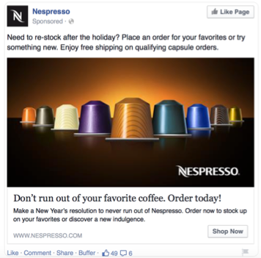

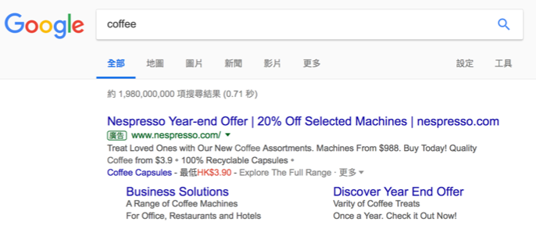

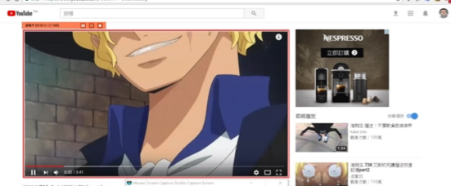

Internet Marketing (e-retailing)
Search engine optimization
PR seeding via social media
Herbal tea
Source: Google, 2018
Notes:
We also suggest optimizing the Search Engine results via keyword searching on major search engine website such as google and yahoo.
To increase the number of appearance and visit to Nespresso website by improving rankings in the search engine results.
Moreover, PR seeding is one of the most important ways to promote our new product via social media. Apart from advisement placement such as page post ad, sponsor ad in Facebook, we can post the tips and the best combination of herbal tea with moody photos or video in different kinds of social media like FB, IG and youtube. Also, we will invite our brand ambassador, Michelle Yeung and some celebrities and media to experience our herbal tea during the promotion period in store, after that we can share the post event photos or video on social media.
Hopefully we can draw as much attention and sales as possible for this new product launch.

Slide 10

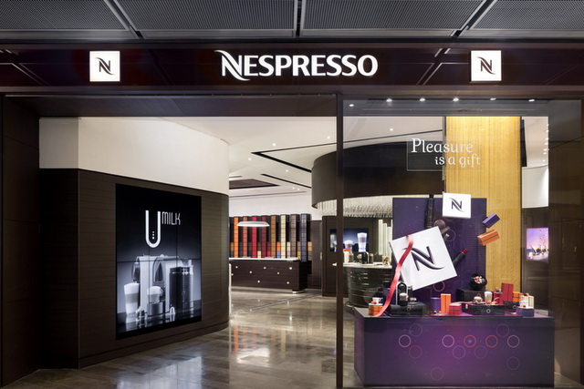
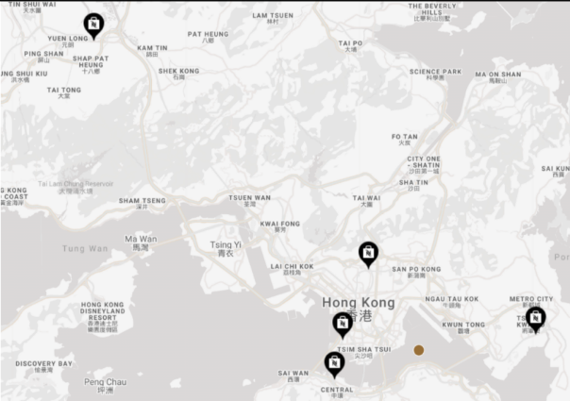
Retailing
3 Boutiques at premium locations (IFC, Elements, Festival Walk)
Benefits: Direct Selling(Personal Touch and Experience)
Allow our customers to try our products and receive advised from our specialised sales team
Warm and welcome atmostphere
A real show window for the brand
Enhance customer shopping experience, Better understand customer behaviors
Potentials:
The Gateway (Tsim Sha Tsui)
Source: Menxpat.com, 2018
Source: Nespresso.com, 2018
Notes:
For Retailing, we currently have 3 boutiques in Hong Kong and they are IFC in Central, Elements at Kowloon Station and Festival Walk Mall in Kowloon.
All of them are located in premium location with good clienteles.
All our boutiques are the base of the experiential marketing strategy. All has been designed so that the customers make themselves comfortable: the atmosphere is warm.
The potential customers can taste the different flavours of our products, try the Nespresso machines and listen to the advices of our specialised salesmen.
The aim is that the customers see the purchase as a pleasant experience which will make them want to come back in the shop and buy other Nespresso products.
Our shops are a real show window for the brand, to show the customers the “Nespresso’s drinker way of living”
Our capsules and accessories are sold exclusively at our boutiques, and the Nespresso machines can be found at both the Nespresso boutiques or
some trustworthy electrical shops like Fortress and Broadway.
Since our current stores are already set up in premium location, we would suggest the Gateway at TST to be our next potential boutique as the location is surrounded by many offices of some big companies. It is a hub of our targeted customers.

Slide 11
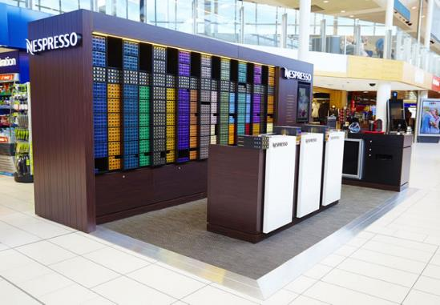
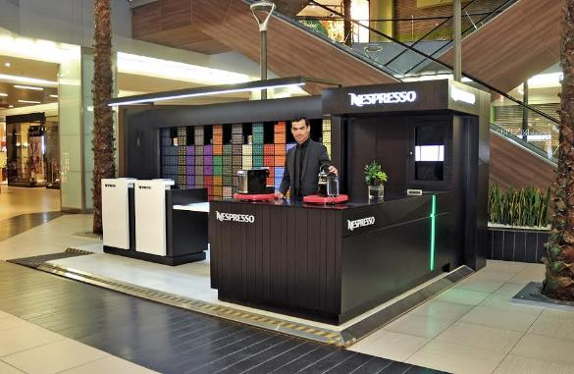
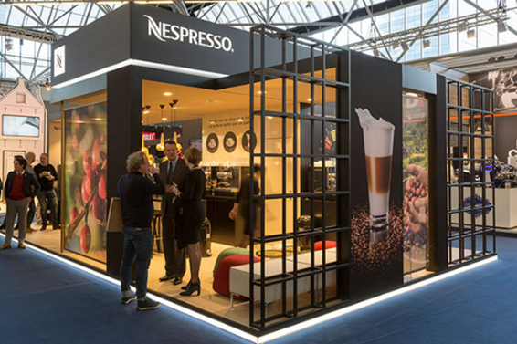
Retailing
2 Pop Up Boutiques at premium locations (Yoho Mall, PopCorn)
Benefits: Flexible Location Selection and Relocation
Easier to set up and adapt to changes
More affordable compare to actual boutiques
Great for promotion activities
Suggestions: MTR (Hong Kong Station), Lane Crawford, Airport, Food & Wine Expo
– High traffic of our target market
Source: Moodiedavittreport.com, 2018
Source: Saboresmas.blogspot.com, 2018
Source: Hypsos.com, 2018
Notes:
We currently have 2 pop up boutiques. One is at the Yoho mall in Yuen Long and the other one is Pop corn Mall in Tseung Kwan O.
Pop-up boutique is a great way to find out if there’s a demand for the new product and help to find out if peoples are prepared to spend the cash for it.
A pop up boutique can be more flexible on location selection and relocation.
For retail stores that want to gain exposure while pop up boutique is often temporary in nature and smaller in size than conventional retail stores,
the cost of rent is relatively lower. It is easier for set up and more adaptable to changes, therefore customers are often more willing to buy immediately if they
feel the pop up boutique or the products will only be there for a short period of time, it is a great chance to raise awareness of the new product and
great for promotion activities.
We would suggest to open up few more pop up boutiques for our new product launch at prime locations such as the MTR Hong Kong Station, Lane Crawford
at Admiralty, and the airport close to airline lounges as those attract higher volume of our target customers. Having one at the Food and Wine Expo can be a great idea too.

Slide 12

Omni-Channels Distribution Strategies
Engage customers via physical store, online website or mobile app, social media.
Provides an seamless and integrated shopping experience
Redefine the customer experience that justify the cost of the product
Trust-Earning from customers
A powerful purchase influencer
Optimize communication channel to target market
SYNERGY
Notes:
So we are adapting an omni-channels distribution strategy which allow engagement between our customers and the brand through various channels such as physical stores,
online website, mobile app and social medias. The goal is provide our customers and utimately our members an seamless and integrated shopping experience at their
convenient and preferences. It also allow us to redefine our product value and provide justification to the cost. It can be a powerful purchase influencer and
the best way to earn trust from our customers. Most importantly to optimize our communication channel to our target market.
That’s the end of our presentation and thank you very much for your attention. Please feel free to raise any questions.

Slide 13
Reference
Newman, C. L., Wachter, K., & White, A. (2018). Bricks or clicks? Understanding consumer usage of retail mobile apps. Journal of Services Marketing, 32(2), 211-222.
Pinto, G. L., Dell’Era, C., Verganti, R., & Bellini, E. (2017). Innovation strategies in retail services: solutions, experiences and meanings. European Journal of Innovation Management, 20(2), 190-209.
Turner, P. (2017). Implementing integrated marketing communications (IMC) through major event ambassadors. European Journal of Marketing, 51(3). 605-626.
Google. (2018). Google. Retrieved from www.google.com
Nespresso. (2018). Nespresso. Retrieved from https://www.nespresso.com/hk/
Nespresso. (2010). The Nespresso Winning Formula. Retrieved from https://www.nestle.com/asset-library/documents/library/presentations/investors_events/investors-seminar-2010/nestl%C3%A9-nespresso-jun2010-girardot.pdf
Nespresso. (2014). Nestlé Investor Seminar. Retrieved from https://www.nestle.com/asset-library/documents/investors/nis-2014-boston/nespresso.pdf
The Marketing Mix. (2018). Place - Marketing Mix Distribution Strategy. Retrieved from http://marketingmix.co.uk/place/
Saboresmas.blogspot. (2018). Saboresmas.Blogspot. Retrieved from http://saboresmas.blogspot.com/2016/12/nuevo-pop-up-store-nespresso.html
Moodiedavittreport. (2018). Moodiedavittreport. Retrived from https://www.moodiedavittreport.com/another-aussie-airport-first-as-nespresso-pops-up-in-sydney/
Hypsos. (2018). Hypsos. Retrived from http://www.hypsos.com/nl-nl/ons-werk/standbouw/nespresso-presenteert-zich-op-horecava-2017.aspx
Menxpat. (2018) Menxpat. Retrived from https://menxpat.com/post/4989?menu=17
Merci-Magazine. (2018). Merci-Magazine. Retrived from https://www.merci-magazine.com/merci-blog/2014/12/25/nespresso-pops-up-in-causeway-bay-to-delight-coffee-lovers

